Slide 1


Slide 2
Changemakers and Creativity

Slide 3
Lesson Objectives
Define what “innovation" means.
Identify a problem you would like to fix.
Collaborate with peers to select a project and create a project plan.
Articulate the history of LEO and how Don Lewis was an innovative visionary.

Slide 4

If you could change one
thing about
the world, what would it be?

Slide 5
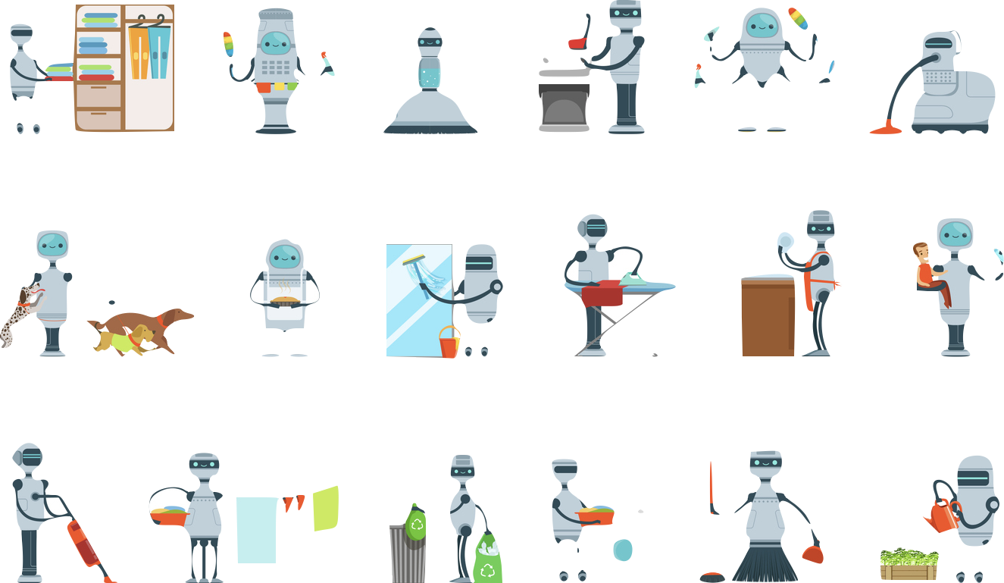
What is one invention that you wish existed today that would make your life easier?
Notes:
Example: coffee robot that brought you coffee when you were tired so you could keep teaching

Slide 6
Answer the first two questions
on your worksheet.

Slide 7
Collaborate with a friend to develop a
project plan for your innovation.

Slide 8
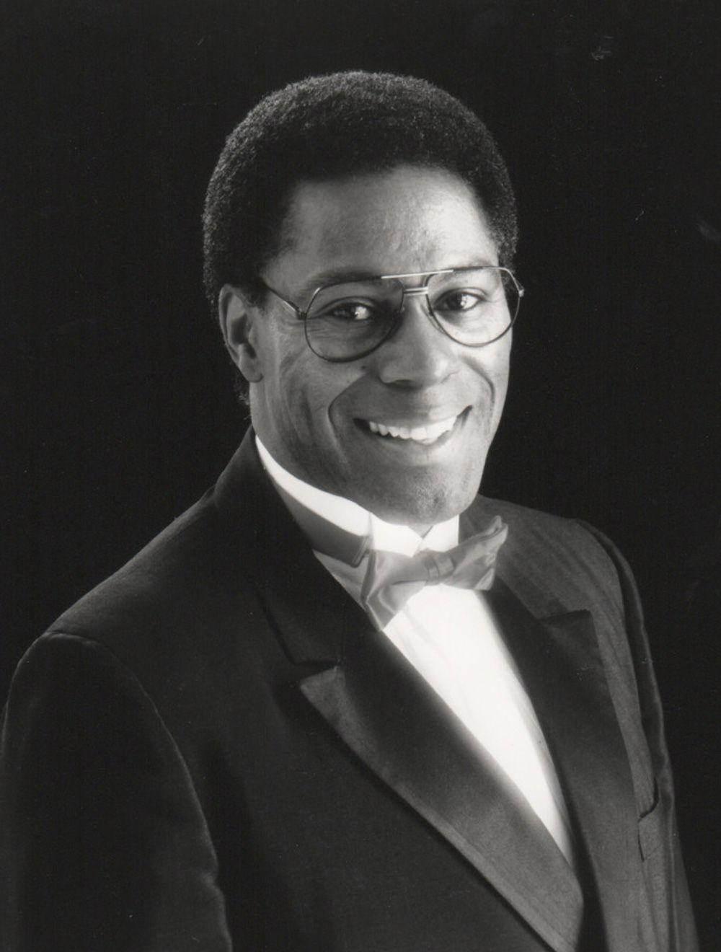
Today, we are going to think like inventors and creative innovators.
We will start with the story of musician, Don Lewis.

Slide 9
What does innovation mean?
A new idea, method, or device.
The introduction of something new.
Can you think of a person in your life that is innovative? Share.

Slide 10
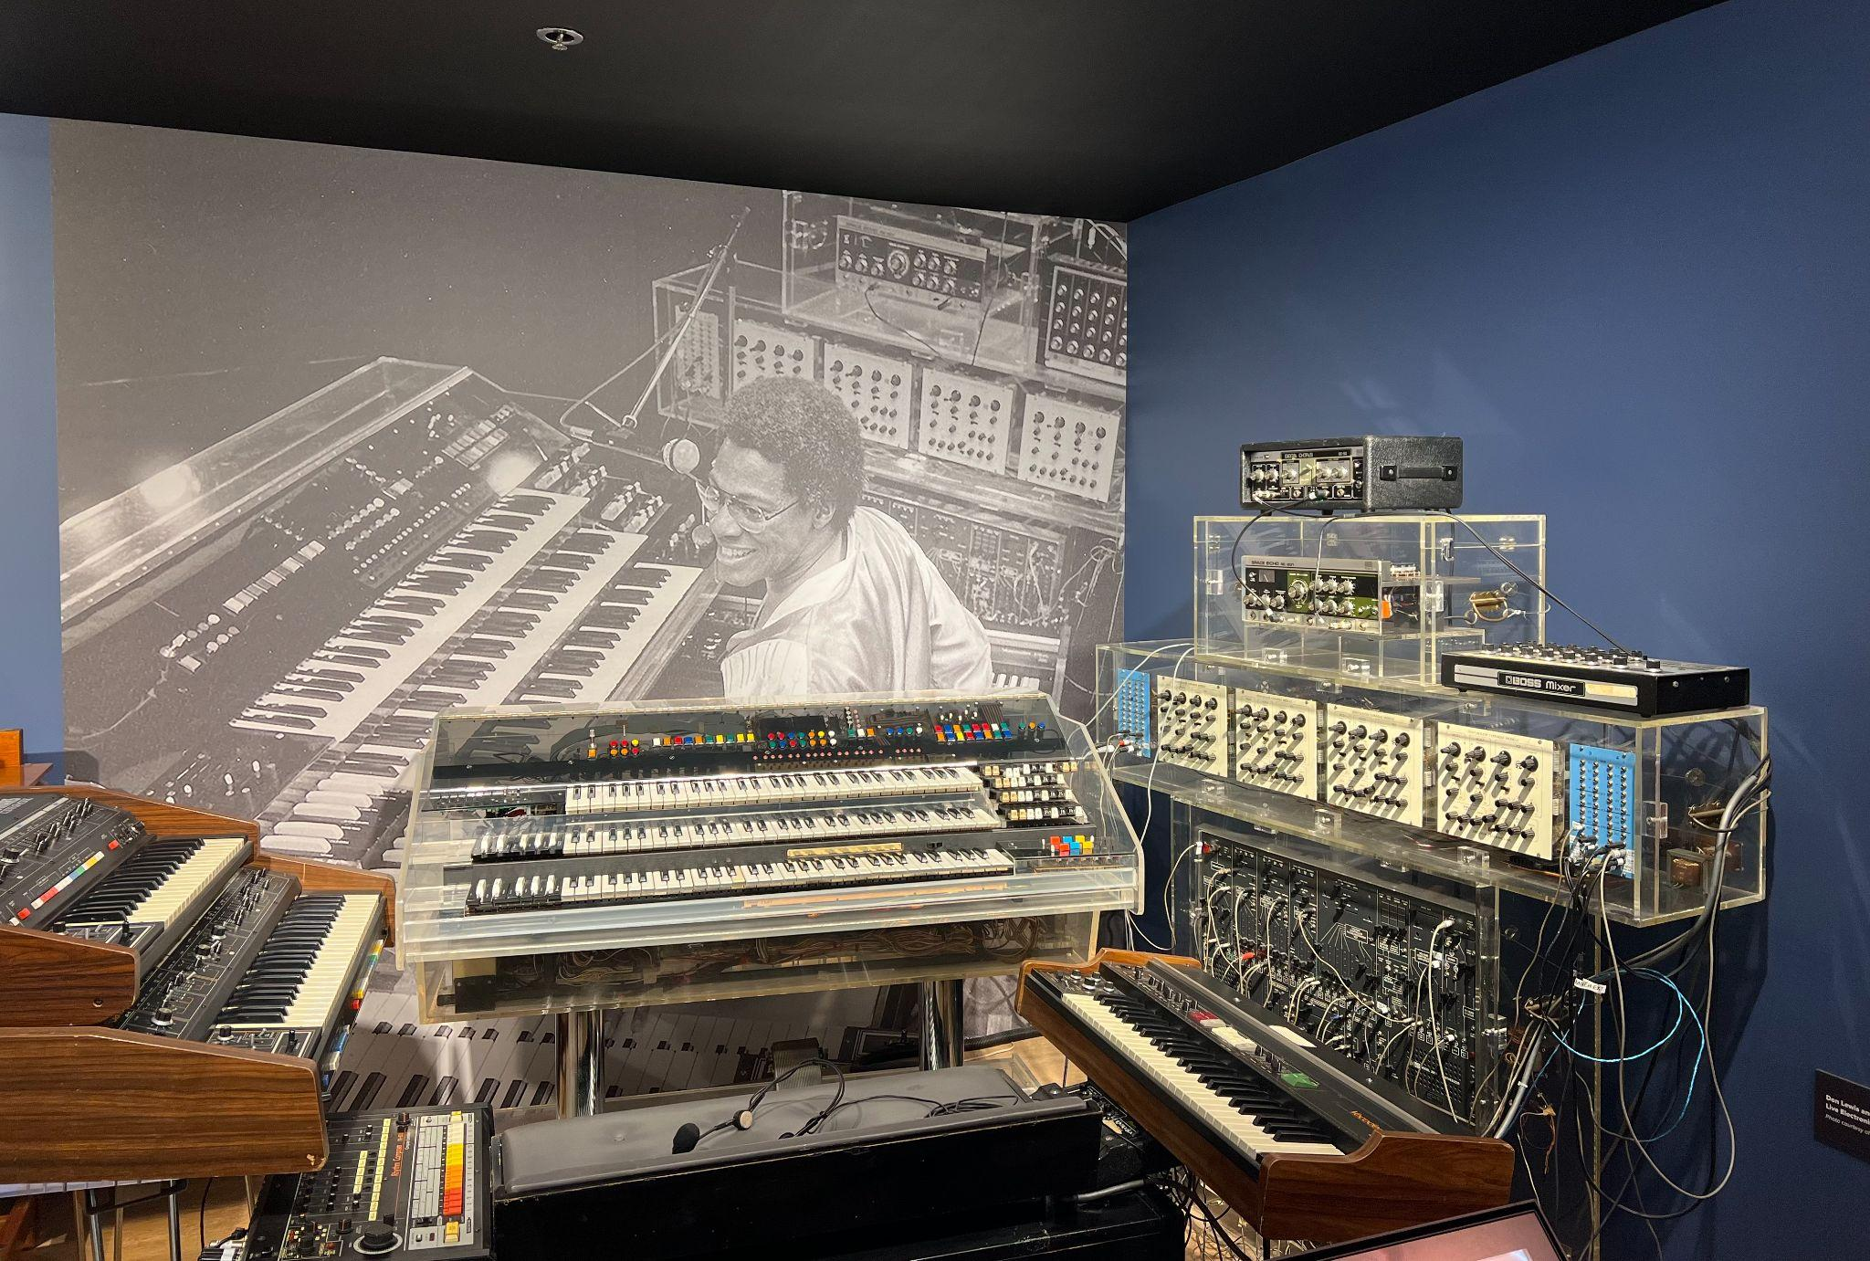
Innovator Spotlight:
Don Lewis
As a child, Lewis wanted to be a conductor and learned the organ.
Lewis was trained as a nuclear weapons specialist.
Lewis decided to create LEO, the "Live Electronic Orchestra" in the 70s by combining different instruments together. This had never been accomplished before!
LEO at the Museum of Making Music

Slide 11

Innovator Spotlight: Don Lewis

Slide 12


Slide 13
Reflect: How did he solve his problem?

Slide 14
Consider a Career in Music!
What careers are related to the lesson we just completed?
Instrumentalist
Performer/Entertainer
Engineer
Product Design and Development

Slide 15


